Slide 1
An experiment in Agile Threat Modelling
Fraser Scott
Notes:
Show of hands
How many / outage / security incident

Slide 2
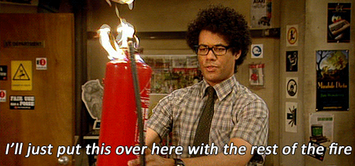
Notes:
“hmm, should probably have thought that through a little bit more...”

Slide 3
To err is human
Notes:
It's inevitable

Slide 4

To propagate error to all server
in automatic way is #devops
@DEVOPS_BORAT
Notes:
devops new challenges
post mortem
what went wrong
lessons learned
create some issues
follow up review

Slide 5
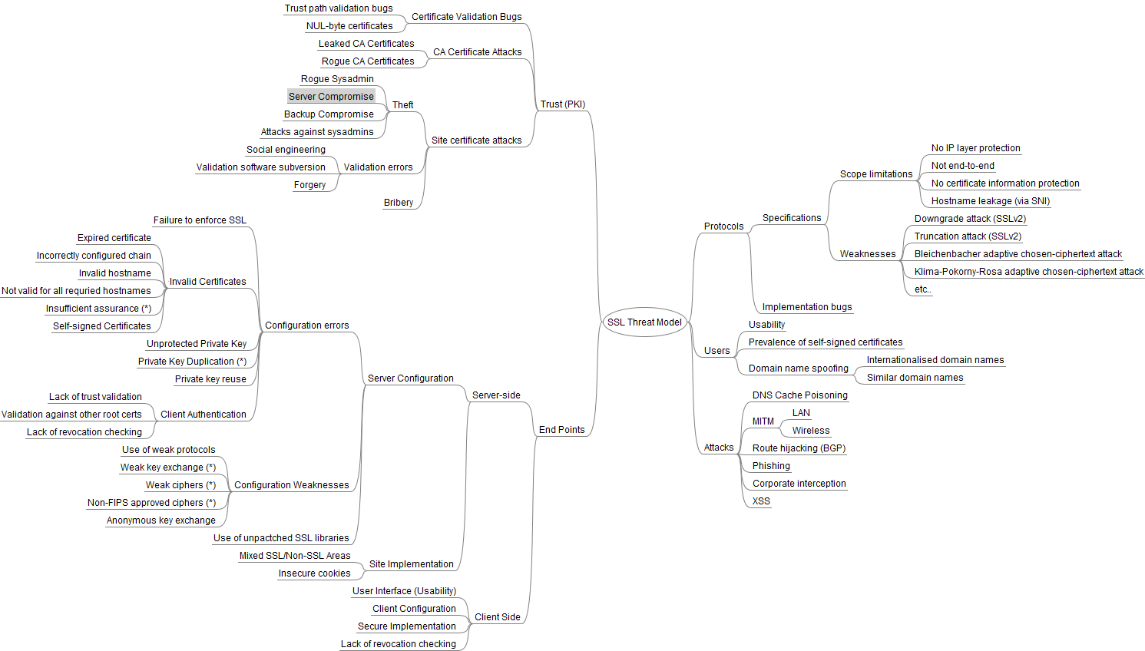
Systematic identification of threats and actions
Notes:
Talk is about threat modelling
post-mortem, *before* the incident happens.
Why would we do formal threat modelling?...

Slide 6

Build better and more robust systems and services
Notes:
Awesome
Operational controls, secure development, automated (security) testing
Baking security in to the design rather than bolting it on..
Ducktape vs robust

Slide 7

Threat Modeling:
Designing for Security
Adam Shostack
Notes:
Read Adam Shostack's book.
Brief Summary
[show of hands]
Who’s done formal threat modelling?

Slide 8
Overview
What are you building?
What can go wrong?
What should you do about the things that can go wrong?
Did you do a good job of 1-3?
Notes:
What is threat modelling?
Involves asking some very important questions.

Slide 9
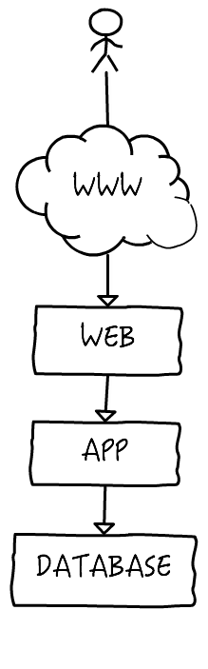
Whiteboard
Notes:
What are you building?
Typical whiteboard diagram from post mortem.

Slide 10
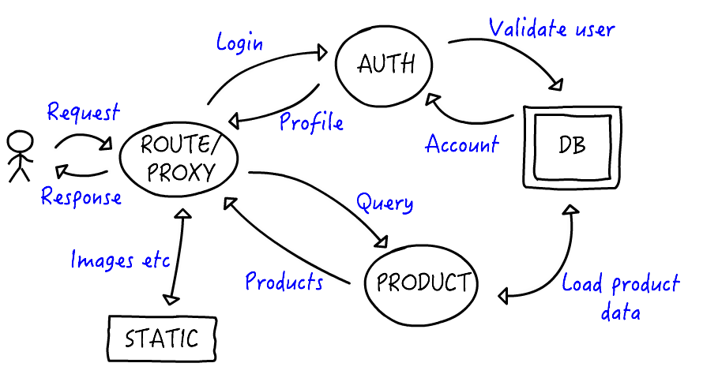
Data Flow Diagram
Notes:
Turn whiteboard into an informal data-flow diagram.

Slide 11
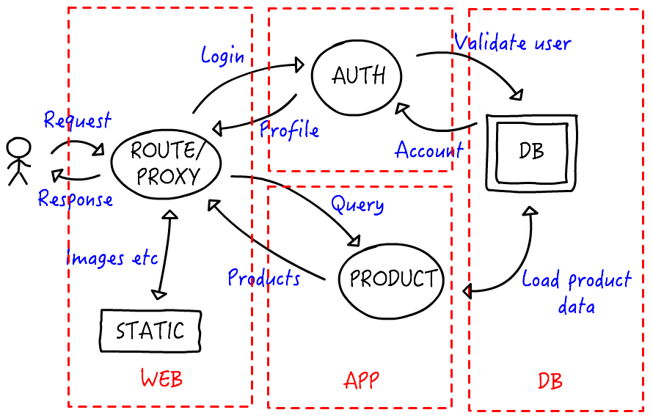
Trust boundaries
Notes:
Add trust boundaries to DFD.
Separation of control and privilege

Slide 12
Assets
Systems – access to data & pivoting
Customer records (i.e. PII)
Product data
Credentials

Slide 13
Attackers
Script kiddies
Hackivists
Professional criminals
ChinNation states

Slide 14
Software
The thing that actually delivers value to your organisation
Notes:
Data-flow diagram maps out the high-level components
Break down to software level.
What you know best.

Slide 15
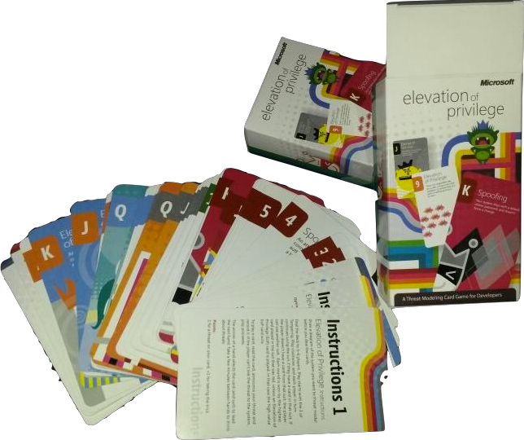
Elevation of Privilege
Notes:
Team with beer + pizza
Distribute cards.
Read threat from card and apply to component. Point for success
Take turns / play all cards.

Slide 16
STRIDE
Spoofing identity
Tampering with data
Repudiation
Information disclosure
Denial of service
Elevation of privilege
Notes:
Different approaches / attack libraries /

Slide 17
STRIDE EXAMPLES
Squatting on a socket or port used by an application
Altering pricing in a product database
Removing an attack from unauthenticated local logs
Reading unencrypted network traffic
Running expensive queries
&admin=1
Notes:
What should you do about threats?

Slide 18
ACTIONS
Mitigate
Eliminate
Transfer
Accept
Notes:
Mitigate = introducing a fix or workaround
Eliminate = removing functionality
Transfer = another party responsible for the risk
Accept = Hope for the best.
Accept is default for inaction
Not threat modelling means to accept all the unidentified risks.

Slide 19
GOOD JOB?
Measurement
Validation
Keep up to date
Notes:
Existing ticketing system to track
Validate models against what was built
Find metrics that work for you

Slide 20
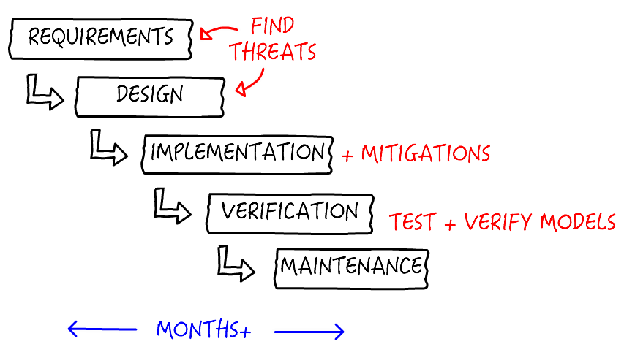
Waterfall

Slide 21
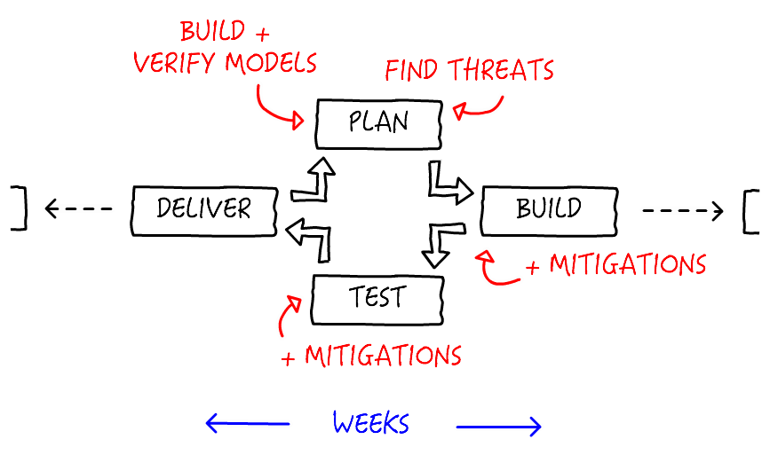
Agile
Notes:
That was a quick intro to TM
What makes me qualified to talk about TM?

Slide 22

Notes:
Nothing really.. I
DevOps-y sysadmin-that-codes
Build and architect systems / security platforms / tools and Infrastructure as Code...
Exactly the type of person that should be involved in TM
pki.io

Slide 23
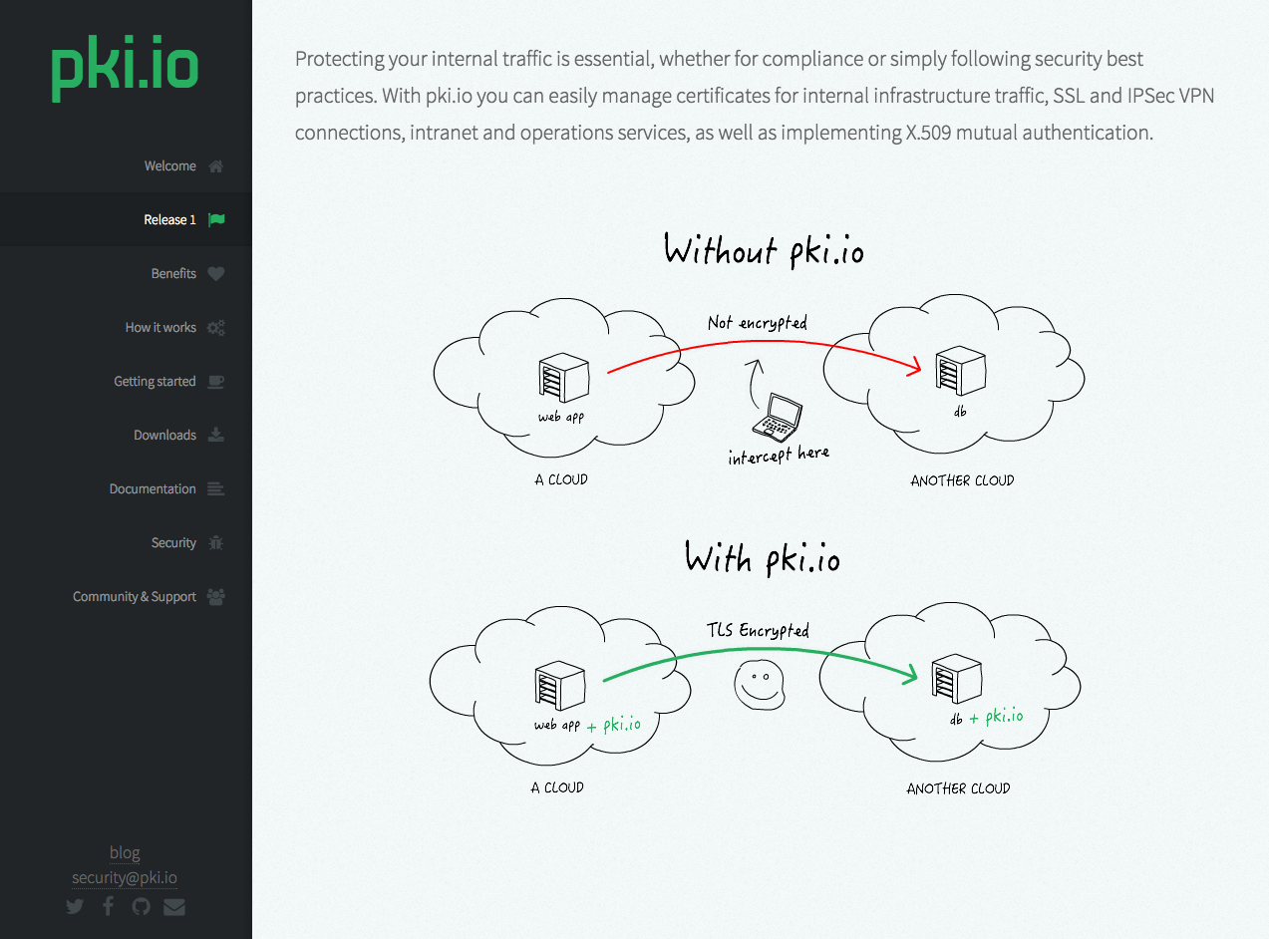

Slide 24
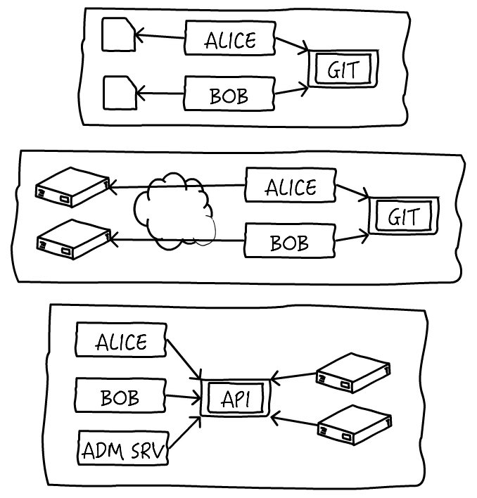
Notes:
3 modes
Security tool so security is a primary concern
security model / secure coding / security tests / disclosure policy / security contact
… threat modelling?...

Slide 25
Distributed developers
Convenient
Self documenting
Notes:
All about the code
Unit testing / TDD and BDD brings testing into the realm of developers..

Slide 26

R-Spec
Cucumber
BDD-Security
GAUNTLT
Notes:
Let's look at some examples.

Slide 27
R-Spec
# in spec/calculator_spec.rb
RSpec.describe Calculator do
describe '#add' do
it 'returns the sum of its arguments' do
expect(Calculator.new.add(1, 2)).to eq(3)
end
end
end
Notes:
Looks like code

Slide 28
Cucumber
Feature: Refund item
Scenario: Jeff returns a faulty microwave
Given Jeff has bought a microwave for $100
And he has a receipt
When he returns the microwave
Then Jeff should be refunded $10
Notes:
Natural language

Slide 29
BDD-Security
Scenario: Present the login form itself over an HTTPS connection
Meta: @id auth_login_form_over_ssl @cwe-295-auth @browser_only
Given a new browser instance
And the client/browser is configured to use an intercepting proxy
And the proxy logs are cleared
And the login page
And the HTTP request-response containing the login form
Then the protocol should be HTTPS
Notes:
BDD applied to security.

Slide 30
GAUNTLT
# nmap-simple.attack
Feature: simple nmap attack to check for open ports
Background:
Given "nmap" is installed
And the following profile:
| name | value |
| hostname | example.com |
Scenario: Check standard web ports
When I launch an "nmap" attack with:
"""
nmap -F <hostname>
"""
Then the output should match /80.tcp\s+open/
Then the output should not match:
"""
25\/tcp\s+open
"""
Notes:
Similar approach for TM?

Slide 31

Code-driven threat modelling
Notes:
Would this work?

Slide 32
“ThreatSpec”

Slide 33
Components
Trust boundaries
Threats
Mitigations
Other stuff
Notes:
scope

Slide 34
Exposes WebApp:FileSystem to arbitrary file writes with insufficient path validation
Mitigates WebApp:FileSystem against unauthorised access with strict file permissions
Notes:
Easy to parse

Slide 35
\s*(?:\/\/|\#)\s*Mitigates (?<component>.+?) against (?<threat>.+?) with (?<mitigation>.+?)\s*(?:\((?<ref>.*?)\))?\s*$

Slide 36
// ThreatSpec TMv0.1 for ExpandKey
// Mitigates App:Crypto against Use of Password Hash With Insufficient Computational Effort (CWE-916) with PBKDF2 provided by standard package
// Mitigates App:Crypto against Use of a One-Way Hash without a Salt (CWE-759) with salt create by function
// Mitigates App:Crypto against Use of a One-Way Hash with a Predictable Salt (CWE-760) with salt created with good PRNG
// ExpandKey is an opinionated helper function to cryptographically expand a key using a 128 bit salt and PBKDF2.
// If the salt is of 0 length, it generates a new salt, and returns the expanded key and salt as byte arrays.
//
// A salt should only be provided as part of a decryption or verification process. When using ExpandKey to create a new key, let ExpandKey generate the salt. This is to lessen the risk of a weak or non-unique salt being used.
func ExpandKey(key, salt []byte) ([]byte, []byte, error) {
if len(salt) == 0 {
var err error
salt, err = RandomBytes(16) // TODO Shouldn't be hardcoded i guess
if err != nil {
return nil, nil, err
}
}
newKey := pbkdf2.Key(key, salt, 100000, 32, sha256.New)
return newKey, salt, nil
}
Notes:
Real example from pki.io

Slide 37
ThreatSpec TMv0.1 for ExpandKey
Mitigates App:Crypto against Use of Password Hash With Insufficient Computational Effort (CWE-916) with PBKDF2 provided by standard package
Mitigates App:Crypto against Use of a One-Way Hash without a Salt (CWE-759) with salt create by function
Mitigates App:Crypto against Use of a One-Way Hash with a Predictable Salt (CWE-760) with salt created with good PRNG
Notes:
Just the TreatSpec

Slide 38
# ThreatSpec Report for ...
# Analysis
* Functions found: 2771
* Functions covered: 4.11% (114)
* Functions tested: 6.14% (7)
# Components
## App Crypto
### Threat: Use of Insufficiently Random Values (CWE-330)
* Mitigation: standard package which uses secure implementation (github.com/pki-io/core:crypto:RandomBytes in ./_vendor/src/github.com/pki-io/core/crypto/helpers.go:74)
### Threat: Use of Password Hash With Insufficient Computational Effort (CWE-916)
* Mitigation: PBKDF2 provided by standard package (github.com/pki-io/core:crypto:ExpandKey in ./_vendor/src/github.com/pki-io/core/crypto/helpers.go:123)
### Threat: Use of a One-Way Hash without a Salt (CWE-759)
* Mitigation: salt create by function (github.com/pki-io/core:crypto:ExpandKey in ./_vendor/src/github.com/pki-io/core/crypto/helpers.go:123)
### Threat: Use of a One-Way Hash
* Mitigation: a Predictable Salt (CWE-760) with salt created with good PRNG
Notes:
threatspec.rb generates markdown

Slide 39
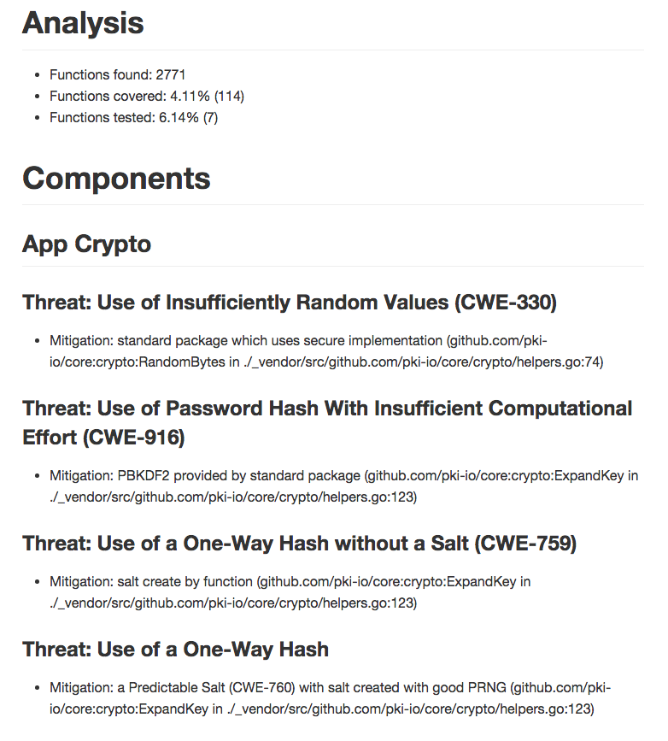

Slide 40
$ callgraph *.go |
./threatspec.rb *.go

Slide 41
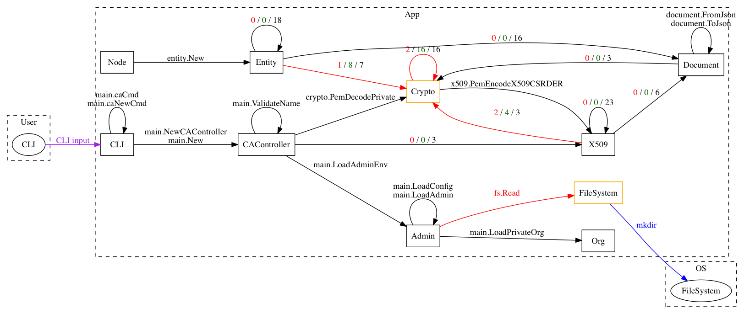

Slide 43
Workflow
Devs write ThreatSpec as they write new functions and tests
Review by security or senior devs
Review of generated reports and DFDs
Notes:
Experiment
Real-world workflow might be like…
SOC dynamic DFD

Slide 44
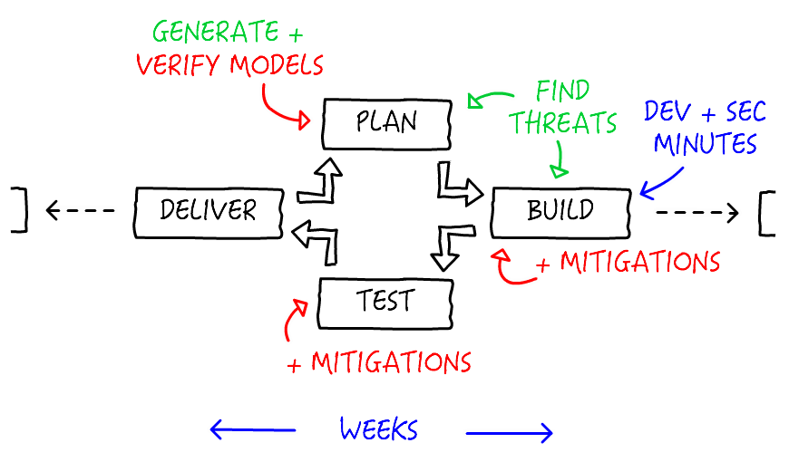
Code-Driven
Notes:
Find threats in plan + build
Generate models whenever
Dev + Sec working together
We've gone from weeks to minutes.

Slide 45
Problems?
Starting point – rough DFD
Complexity of generated DFD
External libraries etc
Dynamic call flows
Notes:
== Strategies
- breath vs depth
- front to back vs back to front
hacks
* dynamic call flow

Slide 46
The good stuff
Dev and Sec working together
Bigger picture
Model and code in sync
Notes:
* devs learn from sec
* sec contributes directly – no more “No”
*

Slide 47

In conclusion...

Slide 48
Threat modelling is awesome
You should probably be doing it
Get people involved
Find an approach that works for you
Code-driven threat modelling may work

Slide 49

The future?
Improvements
Ceremony
Infrastructure as code
Notes:
* threatspec-go, threatspec-report, threatspec-dfd
Native comment parsing?

Slide 50
threatspec.org
Thank You
Image credits available at http://threatspec.org/credits.html

